Slide 1

Ansible Lookup Plugins
Agenda:
Quick recap: Where lookup runs vs where task runs
Deep dives:
url,
ini,
fileglob,
password,
first_found
When to use lookup() vs query() in these cases
Best practices: errors=ignore, split_lines, from_json/from_yaml
Mini demos + troubleshooting tips
Wrap-up and what's next

Slide 2
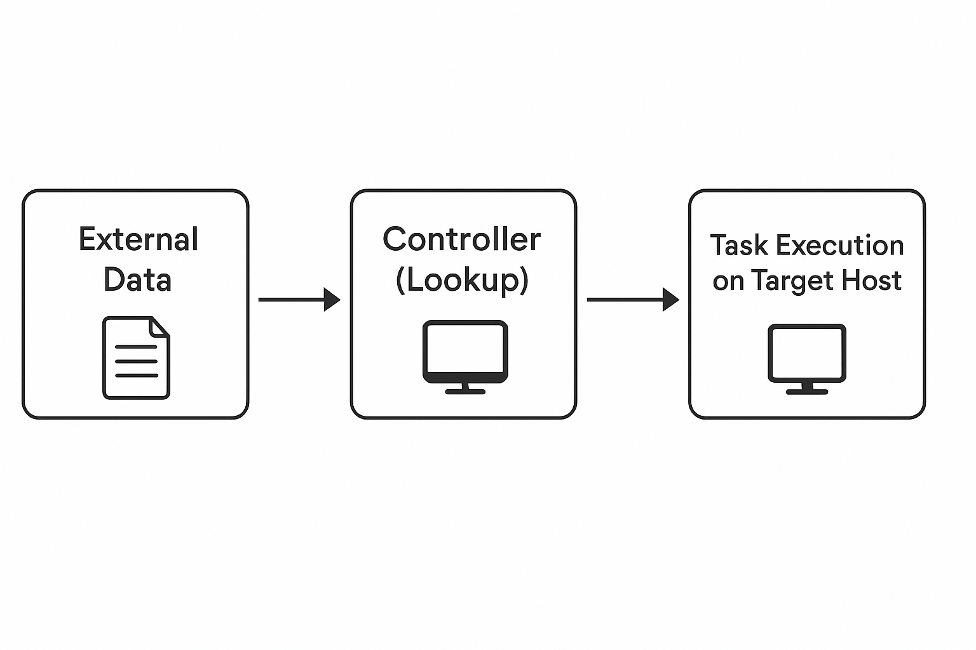
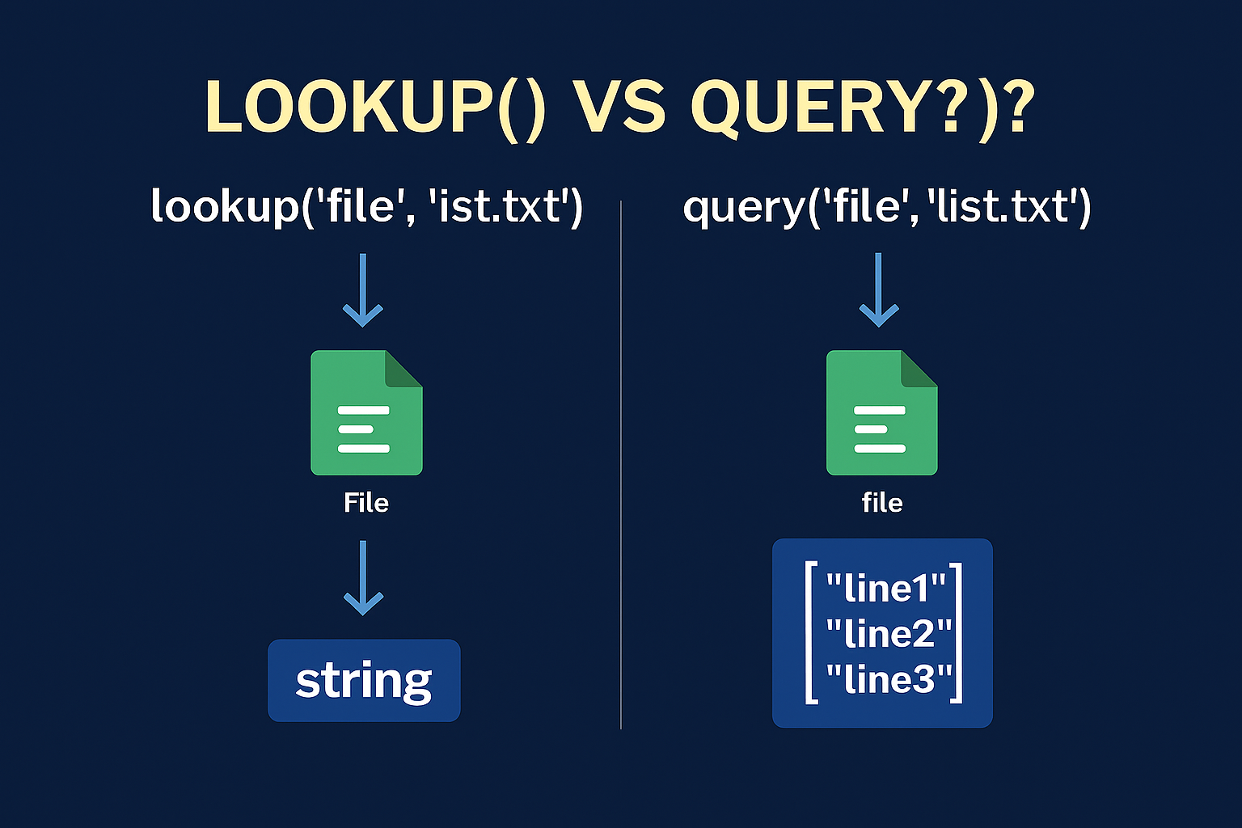
Recap — Execution Flow
Lookups run on the controller; tasks execute on target hosts
Flow: External Data → Controller (Lookup) → Task on Target
Use query() when you expect multiple results (lists)

Slide 3
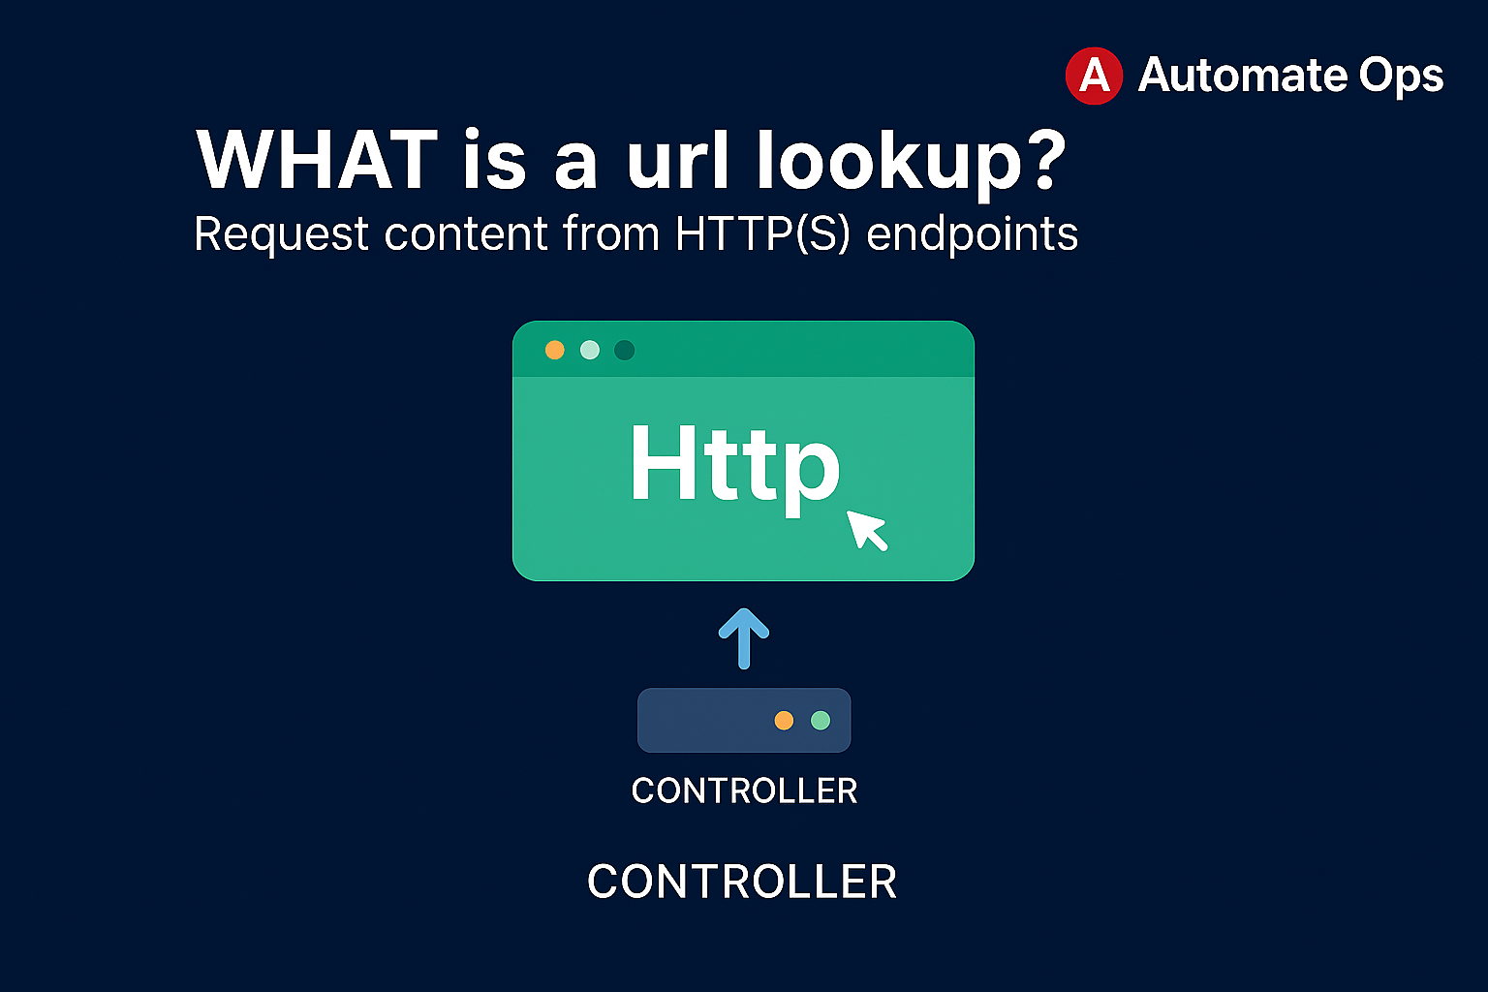
url
Fetch content from HTTP/HTTPS endpoints on the controller
Use for config fragments, metadata, or JSON payloads
Set validate_certs=no for lab-only HTTPS with self-signed certs (avoid in prod)

Slide 4
Example — url lookup (JSON)
Example1
vars: raw_json: "{{ lookup('url', 'https://httpbin.org/json', split_lines=False) }}" data: "{{ raw_json | from_json }}" - name: Show title from JSON ansible.builtin.debug: msg: "{{ data.slideshow.title }}"
Example 2
vars:
raw_yaml: "{{ lookup('url', 'https://example.local/config.yaml', split_lines=False) }}"
cfg: "{{ raw_yaml | from_yaml }}"

Slide 5
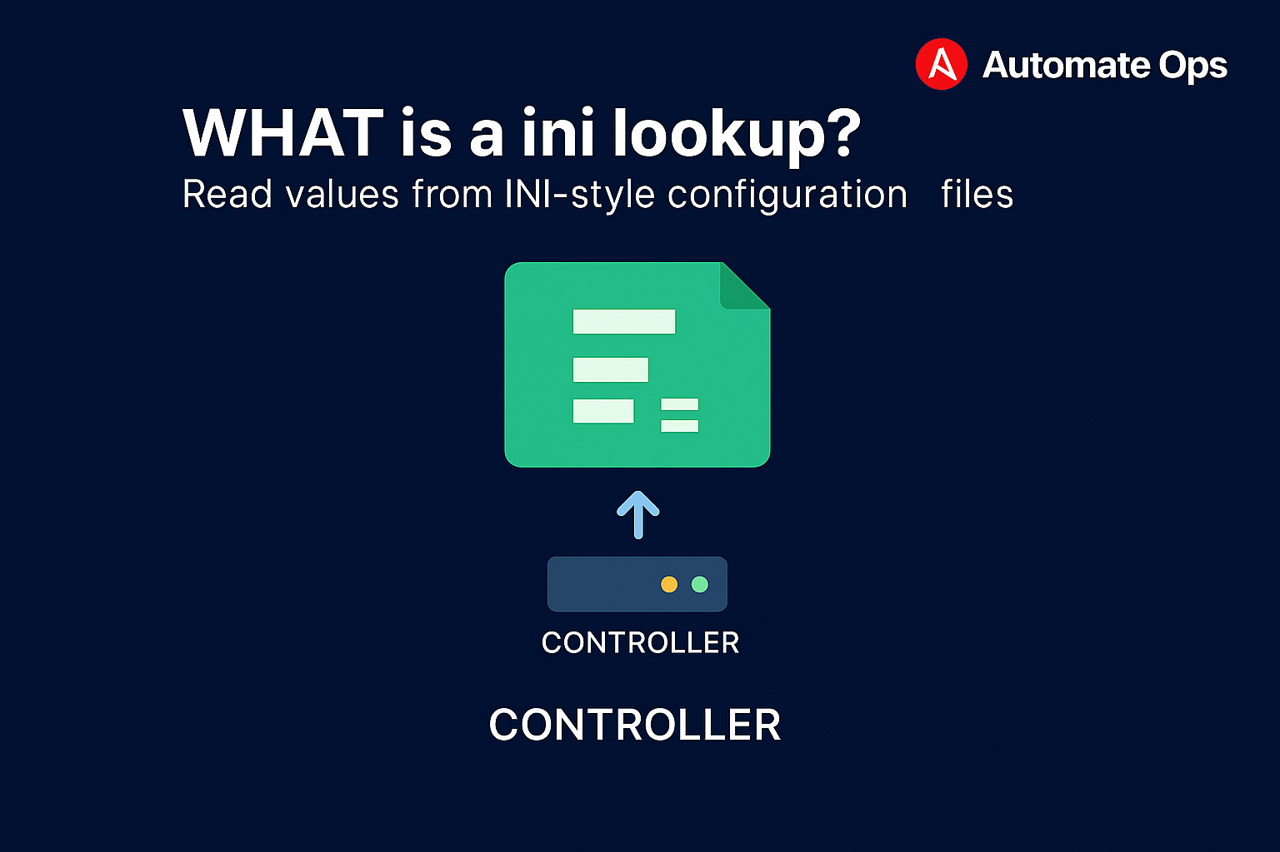
ini
Read values from INI-style configuration files
Great for reusing app config already stored in .ini/.properties
Specify section, option, and file path

Slide 6
Example — ini lookup
vars: db_user: "{{ lookup('ini', 'user section=database file=files/app.ini') }}" db_host: "{{ lookup('ini', 'host section=database file=files/app.ini') }}" - name: Show DB settings ansible.builtin.debug: msg: "db_user={{ db_user }}, db_host={{ db_host }}"

Slide 7
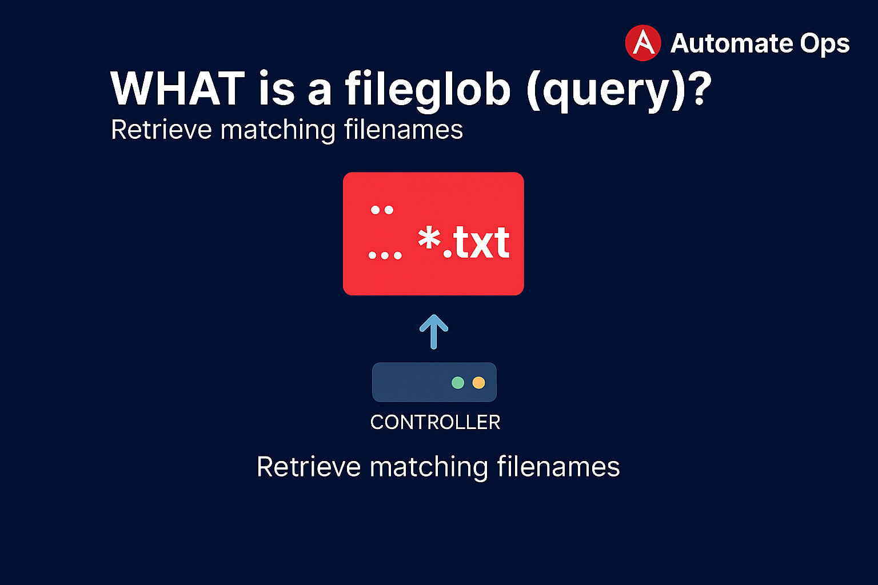
fileglob — query
Return a list of matching files from the controller
Use query() (returns list) — perfect with loops
Common for batching templates or config fragments

Slide 8
Example — fileglob query
- name: Find all .conf files vars: files: "{{ query('fileglob', 'files/*.conf') }}" ansible.builtin.debug: var: files - name: Deploy configs ansible.builtin.copy: src: "{{ item }}" dest: "/etc/myapp/{{ item | basename }}" loop: "{{ files }}"

Slide 9
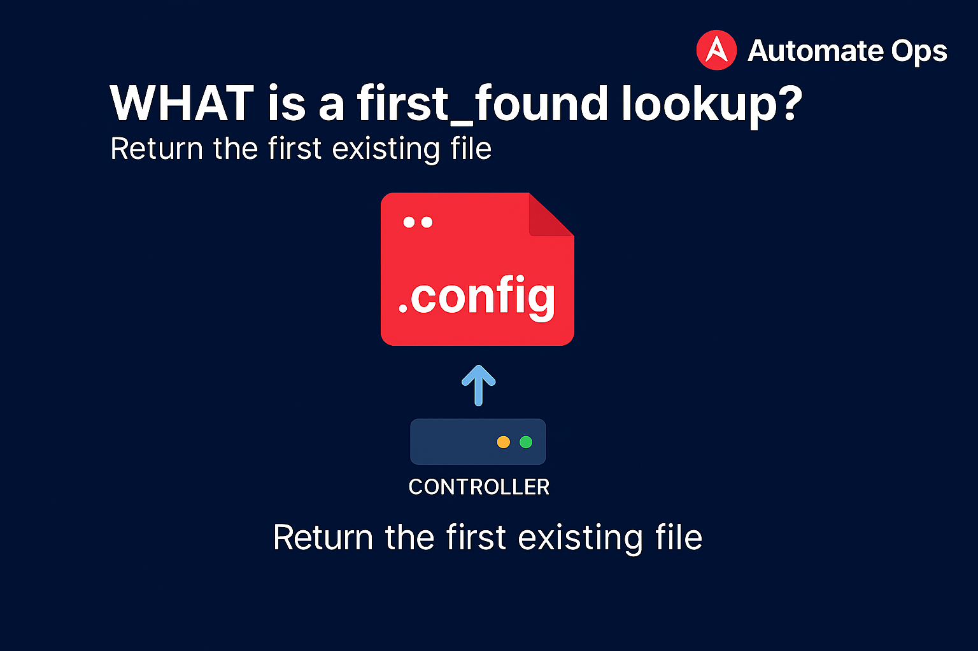
first_found — lookup
Return the contents of the first existing file from a list
Useful for env overrides: prod > qa > dev
Combine with errors=ignore to avoid fatal failures

Slide 10
Example — first_found
vars: cfg: "{{ lookup('first_found', params, errors='ignore') }}" params: files: - "files/config/{{ env }}.cfg" - "files/config/default.cfg" - name: Show selected config ansible.builtin.debug: msg: "{{ cfg }}"

Slide 11
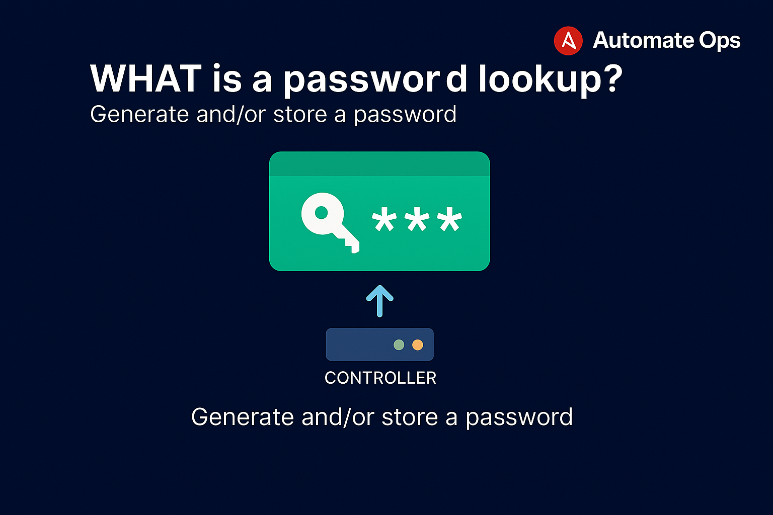
password — lookup
Generate or retrieve a password and (optionally) store it on the controller
Great for idempotent secrets during first run
Control length and character set via options

Slide 12
Example — password lookup
vars: app_password: "{{ lookup('password', '/tmp/.app_pass length=20 chars=ascii_letters,digits') }}" - name: Use generated password ansible.builtin.debug: msg: "Generated password length={{ app_password | length }}"

Slide 13
Best Practices
Use errors=ignore when optional data may be missing
Use split_lines=false to keep JSON intact; then parse with from_json
Prefer query() when looping (lists) to avoid type surprises
Keep secrets out of Git; use env, Vault, or password lookup
Validate data and add sensible defaults to avoid task failures

Slide 14
Troubleshooting Tips
Add -vvv to see lookup execution details on the controller
Confirm working directory if relative paths fail
Check permissions for files/commands used by pipe and file lookups
When in doubt, run against localhost and register results

Slide 15
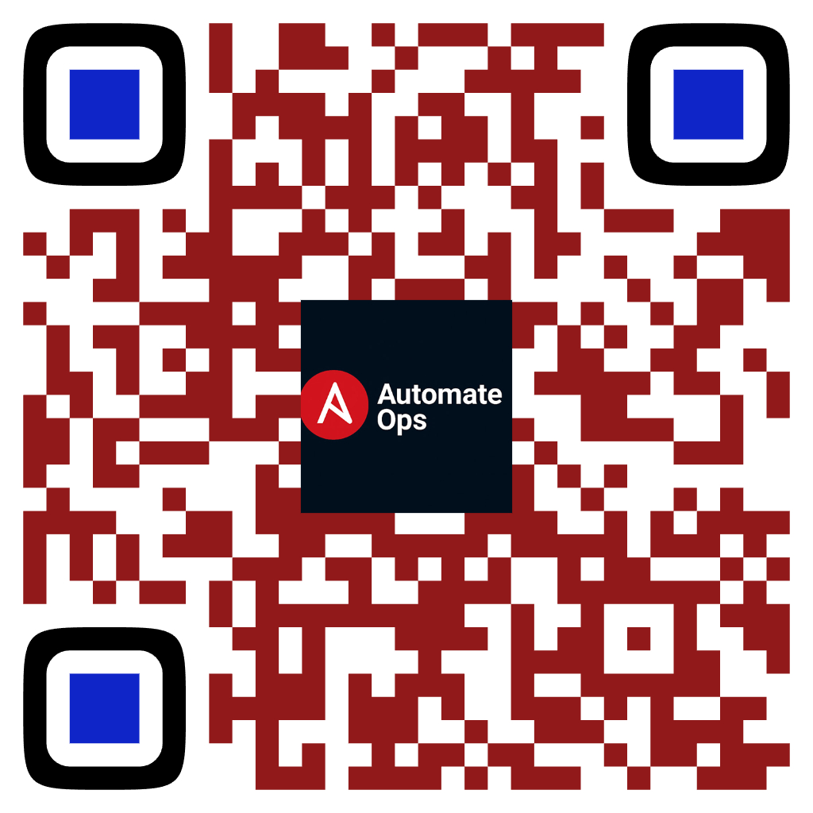
Where lookup runs vs where task runs
Key Takeaways — Lookup Plugins in Action
You practiced controller‑side lookups that fetch first, then tasks run on targets.
You can now use url (fetch HTTP/HTTPS content) and parse safely with from_json.
You can read config from ini files and cleanly inject them into tasks.
You batch files with fileglob (use query() for lists and loops).
You select environment‑specific configs with first_found (with safe fallbacks).
You generate idempotent secrets via password lookup (stored on the controller).
Best practices reinforced: errors=ignore, split_lines=false, parse JSON/YAML, prefer query() when looping.
Scan to Subscribe
Up Next:
• Mini Project showcasing demo of each lookup

